Slide 1
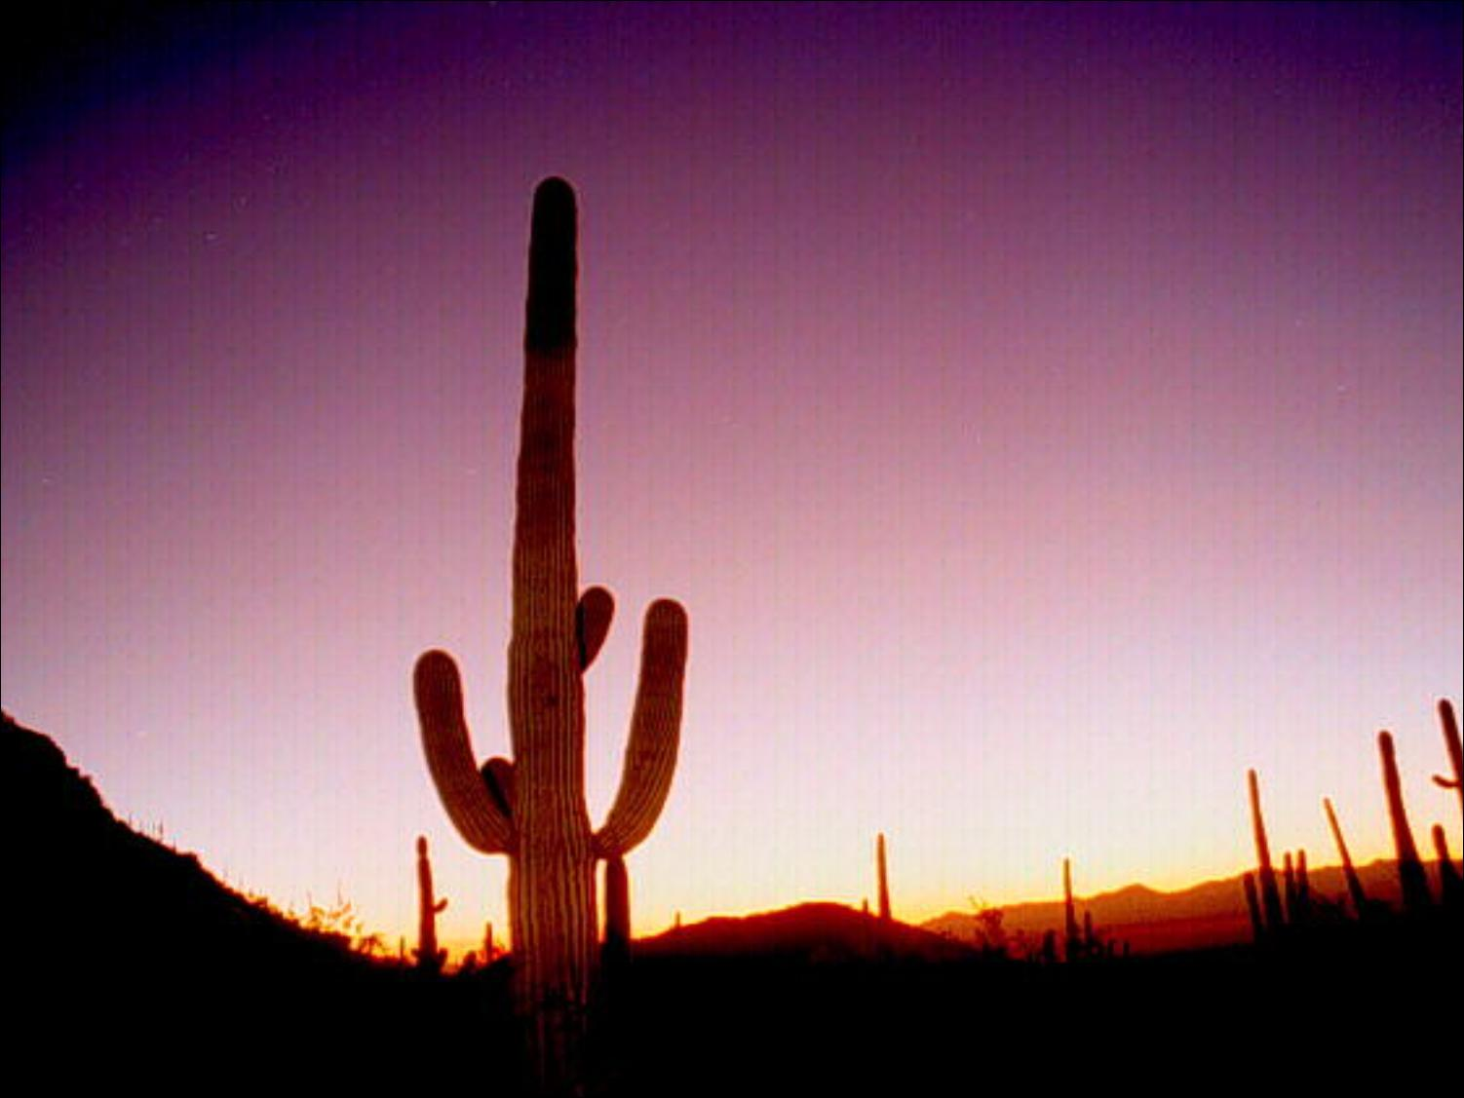
環境応答生理学 2019
Physiology of Environmental Responses （ 2019484208）
Class 3 (15-May, 2019)
且原真木、佐々木
Katsuhara, Sasaki

Slide 2
水輸送系、アクアポリンの多様な機能
Regulation and functions of water transport and aquaporins

Slide 3
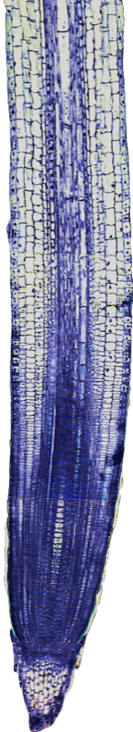
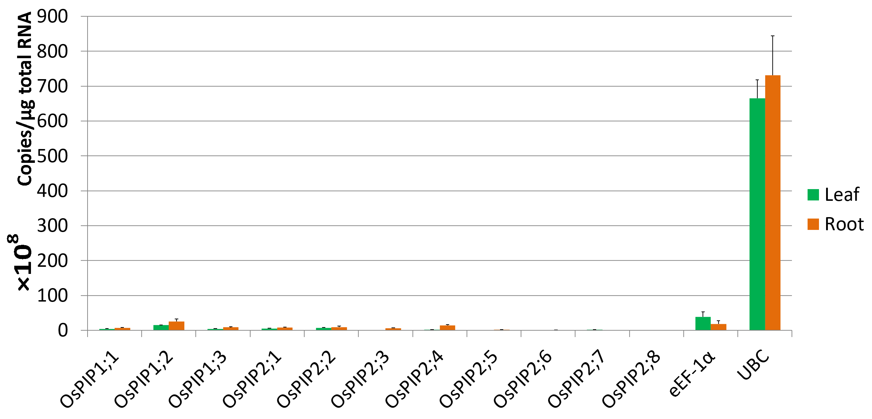
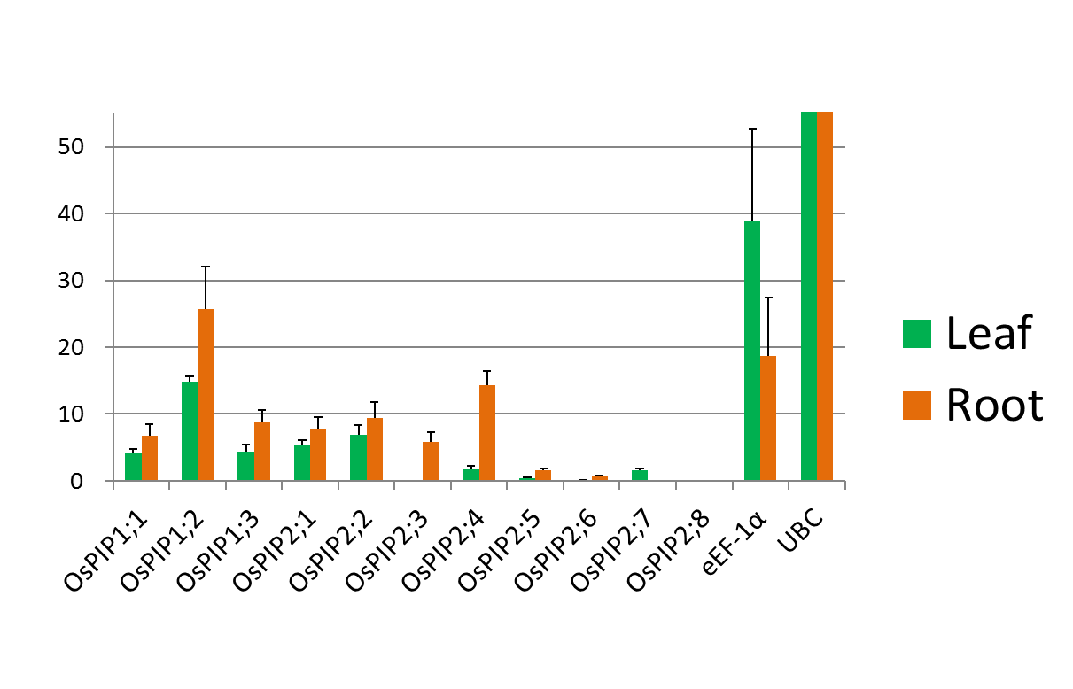
アクアポリンは、実際に根の水透過性を決めているか？
Does aquaporin really determine the root hydraulic conductivity?
Data mean ± SD
n≧3
根で発現の特異性が高い
High root specificity
×10⁸ copies / μg total RNA
H₂O
イネで検証
Examine in rice
Rice PIP expression analysis
Real-time RT-PCR
(absolute quantification)
（Internal standard
（内部標準）

Slide 4
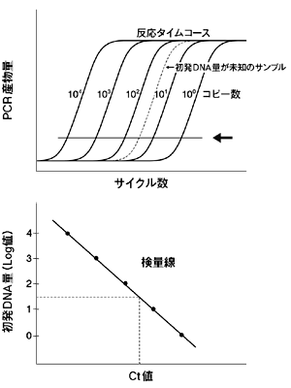
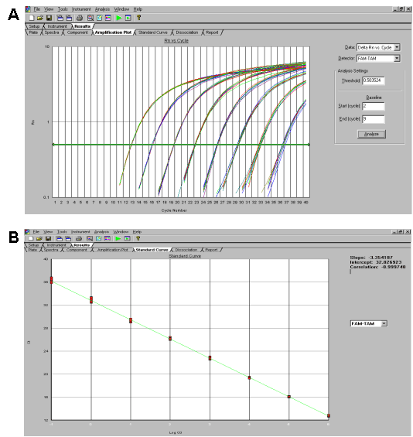
Real-time PCR (absolute quantification)
PCR: 1 cycle 2 hold products (exactly 1.8-1.9 hold)
Certain amount product Initial template amount
Theoretical
Experimental
http://catalog.takara-bio.co.jp/product/basic_info.php?unitid=U100009037
（日本語）
http://www.learningatthebench.com/qpcr-basic5.html （日本語）

Slide 5
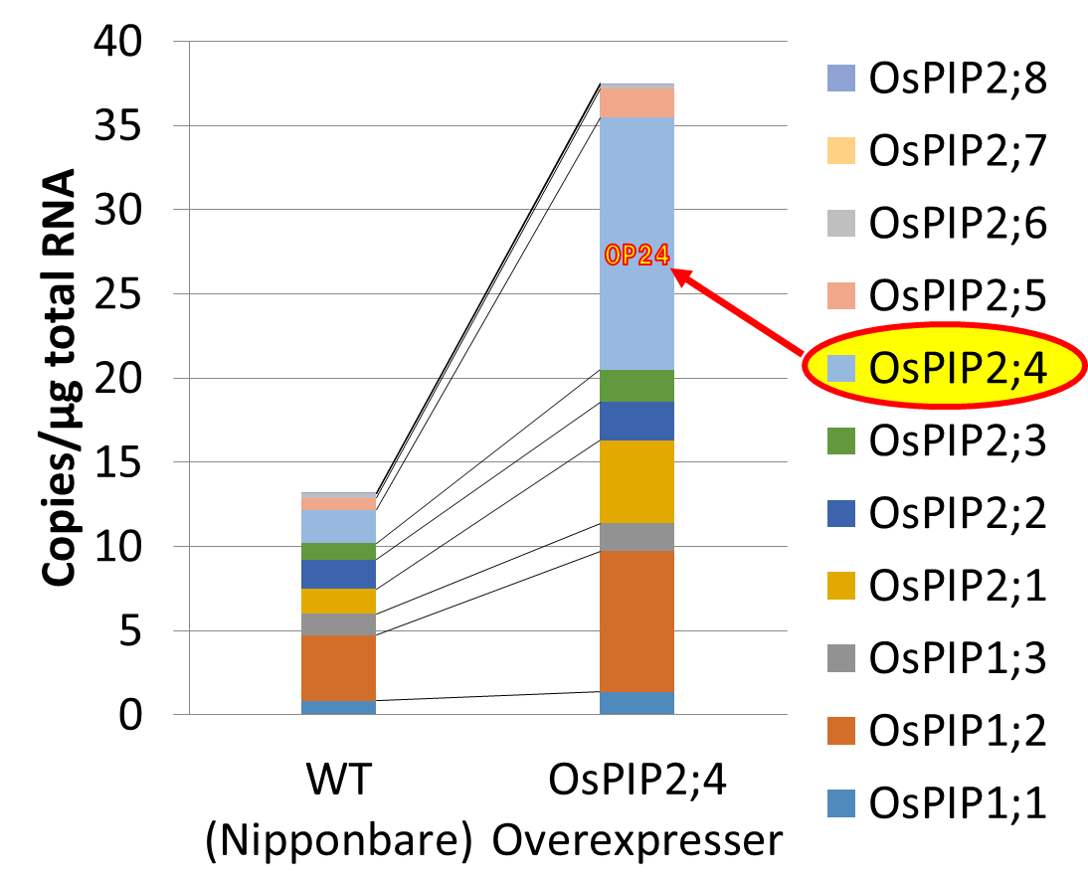
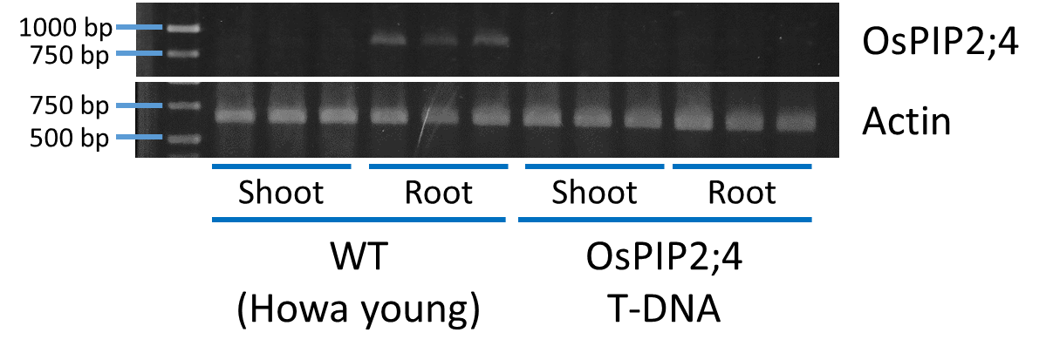
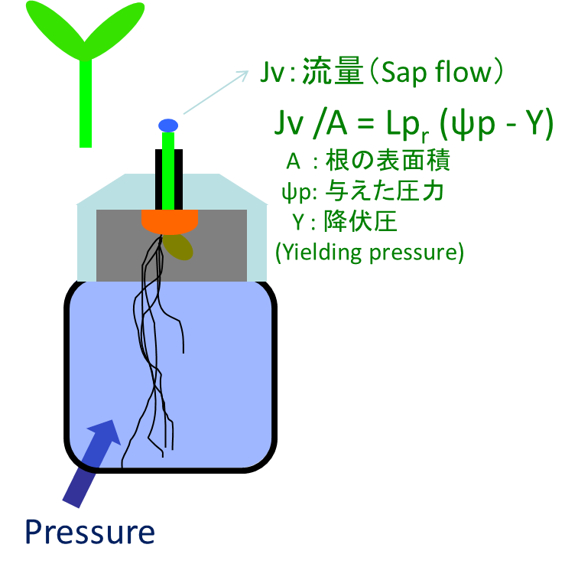
OsPIP2;4Over-expressor (Ox)
OsPIP2;4 Repressor (T-DNA)
x10⁸
Presser chamber
(previously in last class)

Slide 6
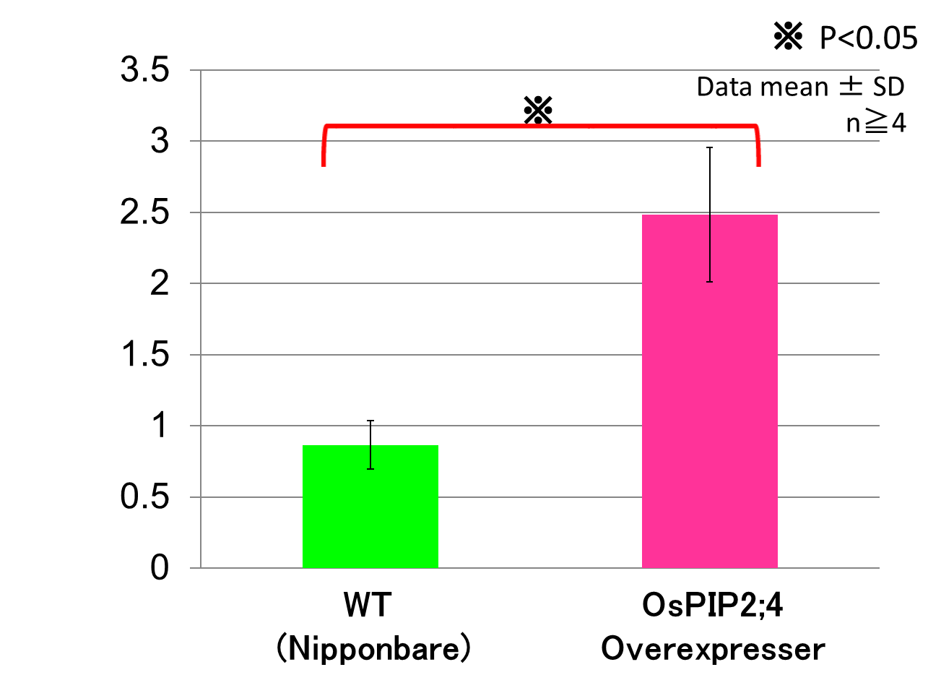
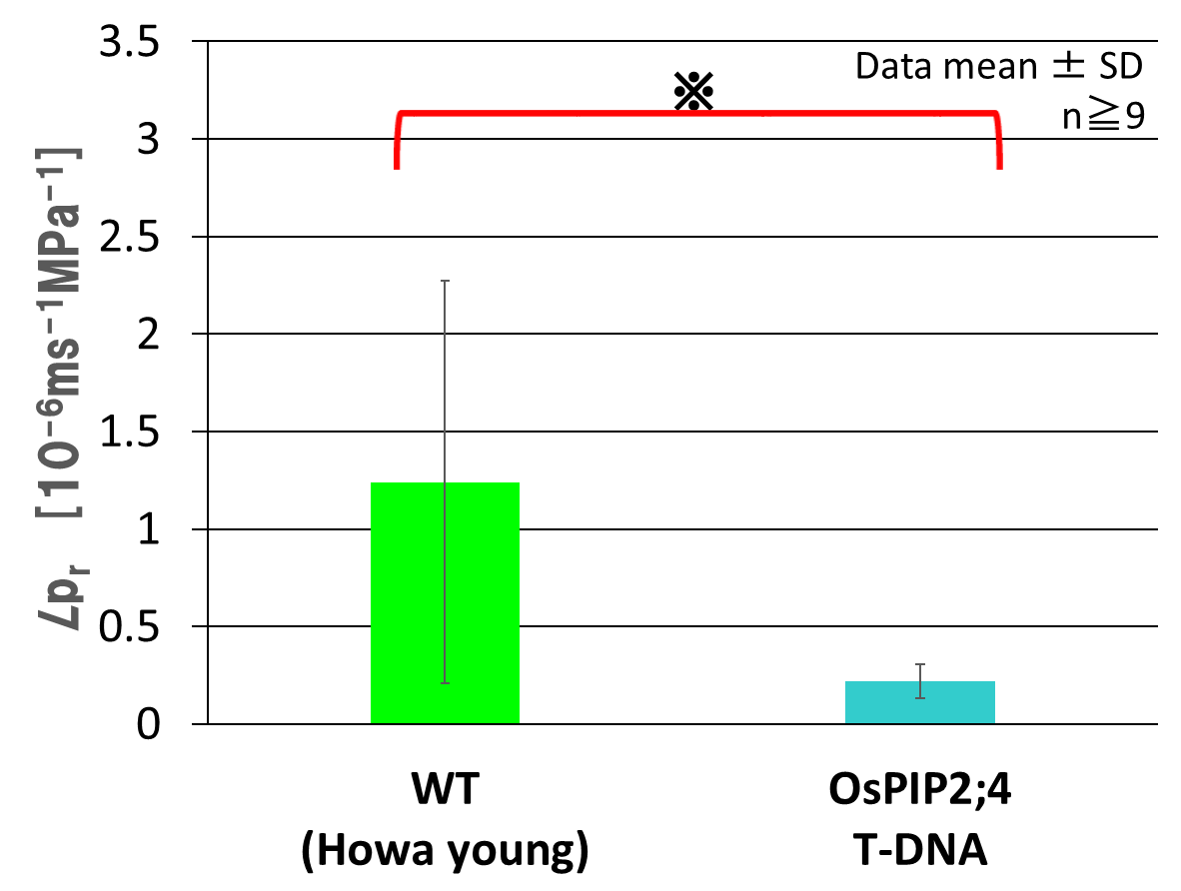
Root hydraulic conductivities (Lp_{r}) of trance genic rice plants with OsPIP2;1
OsPIP2;4 Over-expressor (Ox)
OsPIP2;4 Repressor (T-DNA)
Lp_{r}↑
Lp_{r}↓
Conclusion:
OsPIP2;4 is (one of) main determinant of Lp_{r}.
(Unpublished, 論文未発表、学生のデータ表)

Slide 7

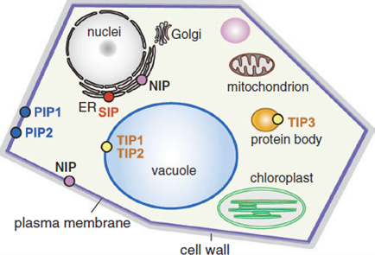
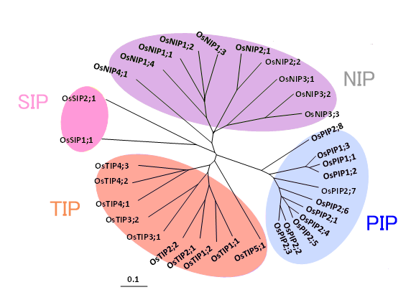
Gene-family of plant aquaporins and sub-classes. （previously shown)
Rice aquaporin genes
Plant Cell Physiology 46:568, 2005 (modified)
 |  | Localization | No. of genes Rice Barley
PIP | Plasma membrane Intrinsic Protein | Plasma membrane (PM) | 11 19
TIP | Tonoplast Intrinsic Protein | Tonoplast (Vacuolar membrane) | 10 10
NIP | Nodulin 26-like Intrinsic Protein | Bacteroid membrane, ER, PM | 10 8
SIP | Small basic Intrinsic Protein | ER membrane | 2 1
Notes:
Rice plant has 33 genes, and 11OsPIPs (3OsPIP1s and 8OsPIP2s)

Slide 8
局在 （Localization)
生理的意味を知るのに重要
Important to know physiological role
方法 How
部位別の遺伝子発現解析 mRNA
(RT-PCR, micro-array, in site hybridization)
部位別のタンパク質発現解析 Protein
(immuno-chemistry/-fluorescence)

Slide 9
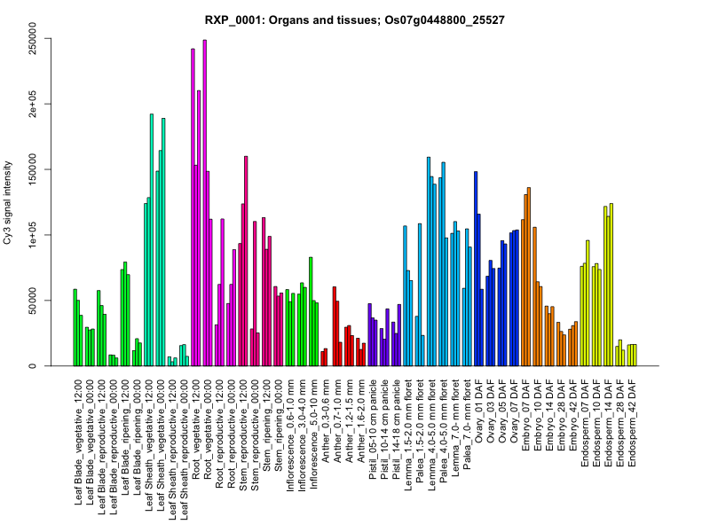
Organ- and developmental-dependent expression analysis
Data from RiceXPro
Microarray
OsPIP2;1 aquaporin
Generally expressed

Slide 10
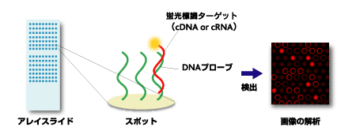
Microarray
Target cDNA probed with fluorescence
(in total cDNA in samples)
Array slide
Detection with fluorescence
Partial sequence complement to each gene
Hundreds gene × samples
(samples = several tissues × developmental stages)

Slide 11
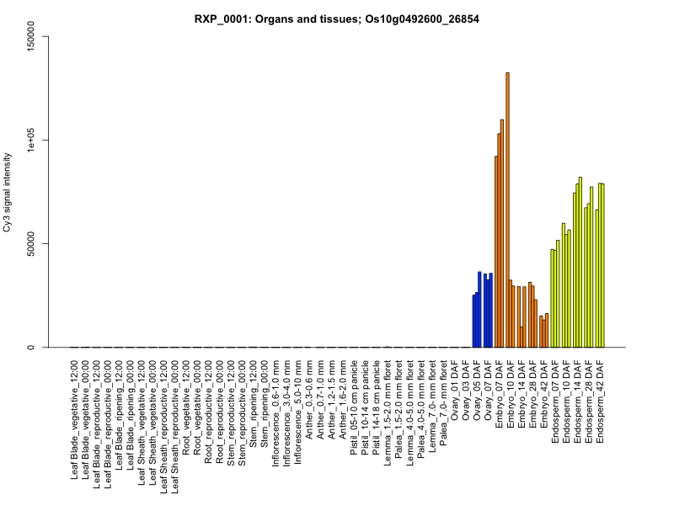
OsTIP3;1 aquaporin
Seed specific

Slide 12
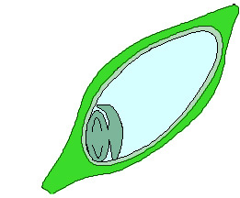
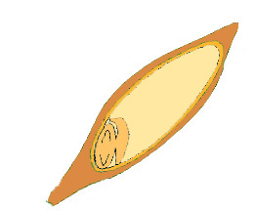
HvTIP3;1 expresses specifically during seed maturation
(Barley) 種子成熟時のオオムギHvTIP3;1
Relative mRNA expression level
RNA isolation from deferent stages → quantitative RT-PCR
Leaf
0 day after pollination
30 day after pollination (seed maturing)
TIP3;1 can be involved in seed desiccation during maturation.
Notes:
In Arabidopsis and rice, TIP gene expression are tissue-specific.
So, I am interested in the expression pattern of HvTIPs.
I checked the expression of these 5 HvTIP genes by quantitative RT-PCR.

Slide 13
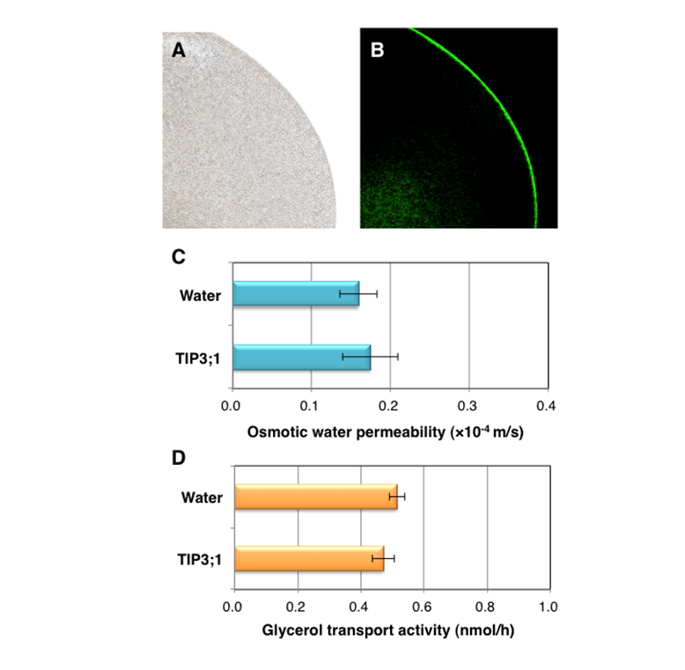
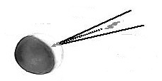

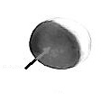
Does TIP3;1 have a water permeability?
Swelling assay using a frog Xenopus oocyte (previously)
HvPIP3:1 （Indirect immuno-fluorescence)
Micro-pipette
(oocyte)
cRNA
Protein expression
Membrane targeting
Aquaporin
Hypotonic treatment
H₂O
Solo-injection showed no increase of water permeability in oocyte.
・・・ rapid water absorption？

Slide 14
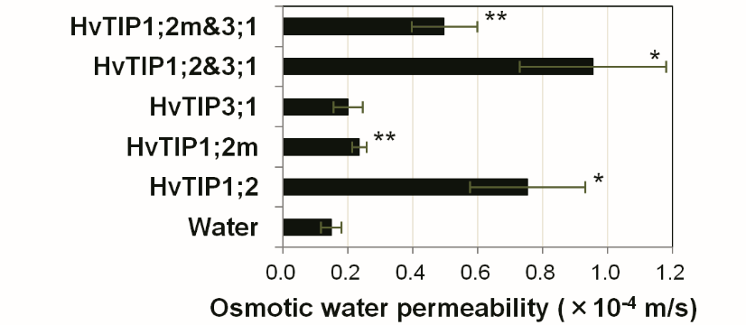
Co-expression of HvTIP3;1 with HvTIP1;2
Hetero-tetramer between HvTIP3;1 and HvTIP1;2
Homo-tetramer of HvTIP3;1
Utsugi et al. PCP 56 (9): 1831-1840 (2015)
HvTIP1;2m ・・・ Ala-195→ Met (water transporte-inactive PIP)
Conclusion:
Interaction induces water transport activity of HvTIP3;1
Utsugi et al. Plant Cell Physiology 56: 1831 (2015))

Slide 15
How about other TIPs?
Germination (root emergency)
(root elongation)
TIP2;1
(old name δ-TIP in Arabidopsis)
TIP1;1 and others
(old name γ-TIP in Arabidopsis)
PIP2;1 and other PIPs
TIP …Vacuole enlargement, cell elongation
Different expression regulation.

Slide 16

Aquaporins in development and tissues・・・・
ナシ果実の肥大 (pear fruit ripping)
初期 early stage
Cell division
中期～後期 mid to late stages
Cell elongation with water absorption
TIP aquaporin・・・expression ↑
PIP aquaporin・・・constant expression
activation with phosphorylation
Dr. Shiratake
Nagoya University
Notes:
16

Slide 17
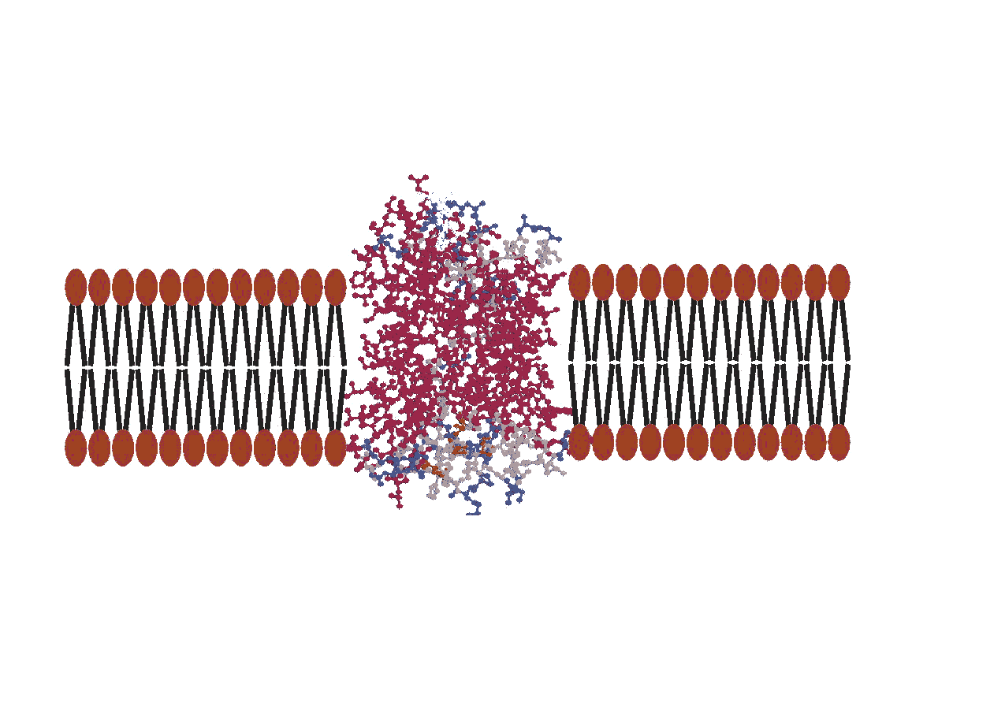
Phosphorylation
（リン酸化）
Dephosphorylation
（脱リン酸化）
H₂O
H₂O
aquaporin
aquaporin
P
Active
（活性化）
Inactive
Less active
（不活性化）
(低活性）

Slide 18
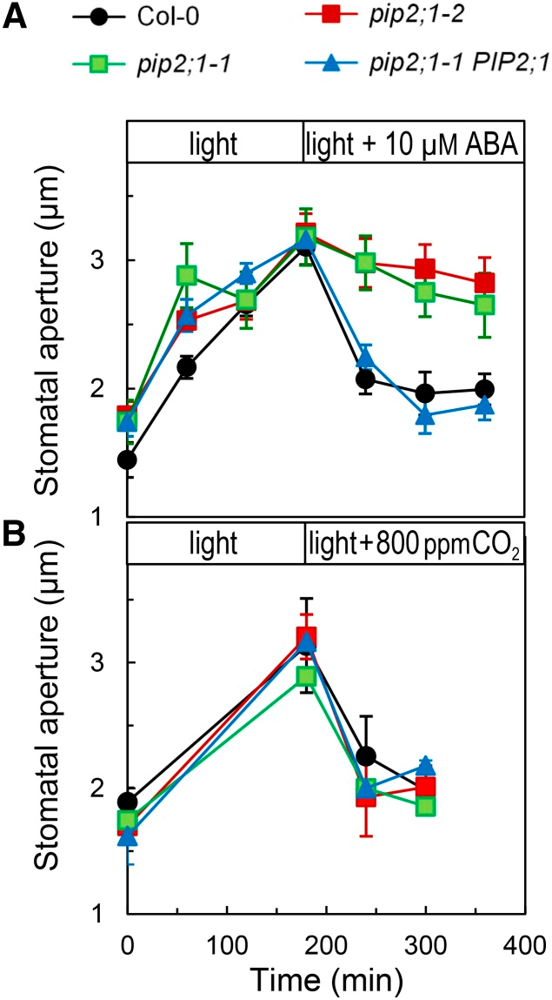
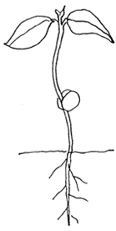
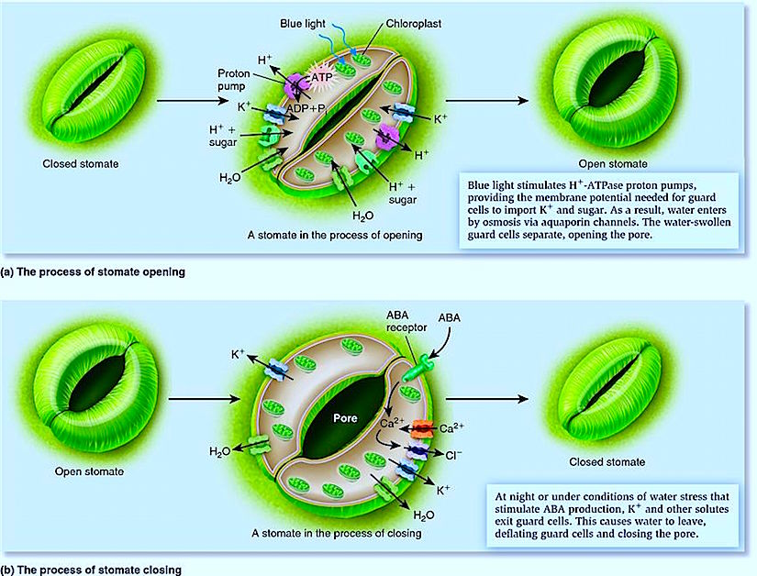
PIPs in stomata guard cell
(孔辺細胞のPIP）
ABA sensing
≠
CO₂ sensing
Fig.1
Aquaporins Contribute to ABA-Triggered Stomatal Closure through OST1-Mediated Phosphorylation.
Plant Cell.27:1945 (2015)
https://plantstomata.files.wordpress.com/2015/09/33_25_07_11_12_56_44.jpeg

Slide 19
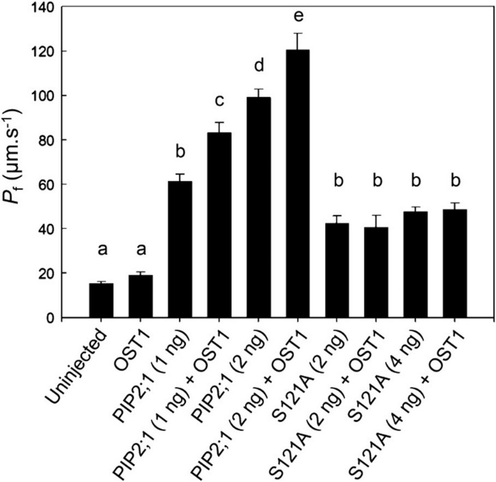
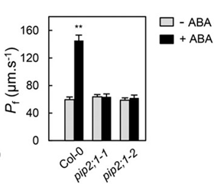
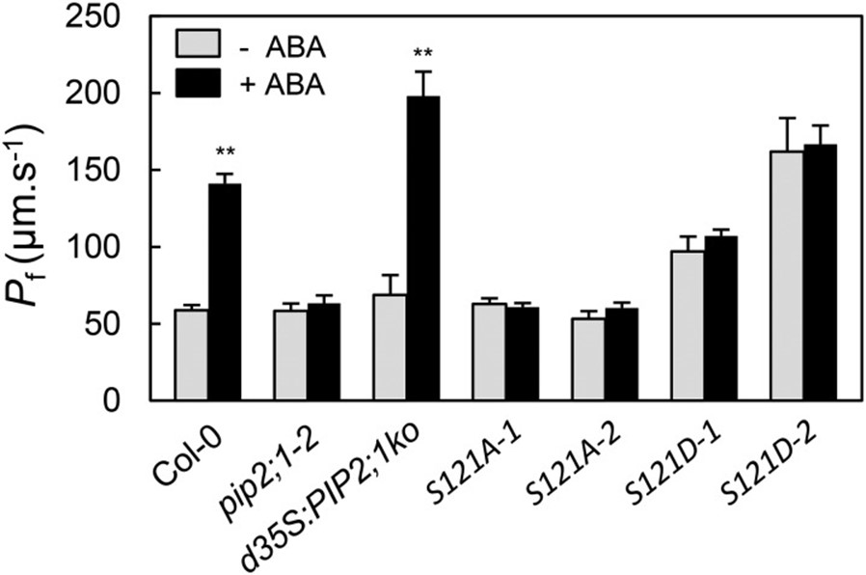
(Plant Cell 2015, Continue)
OST1=
Kinase
（リン酸化酵素）
Guard Cell Protoplasts
Oocytes
Fig.5
Fig.2B
Mimic（模倣）
S121A:
Dephosphorylation
S121D:
Phosphorylation
Protoplasts
Fig.6

Slide 20
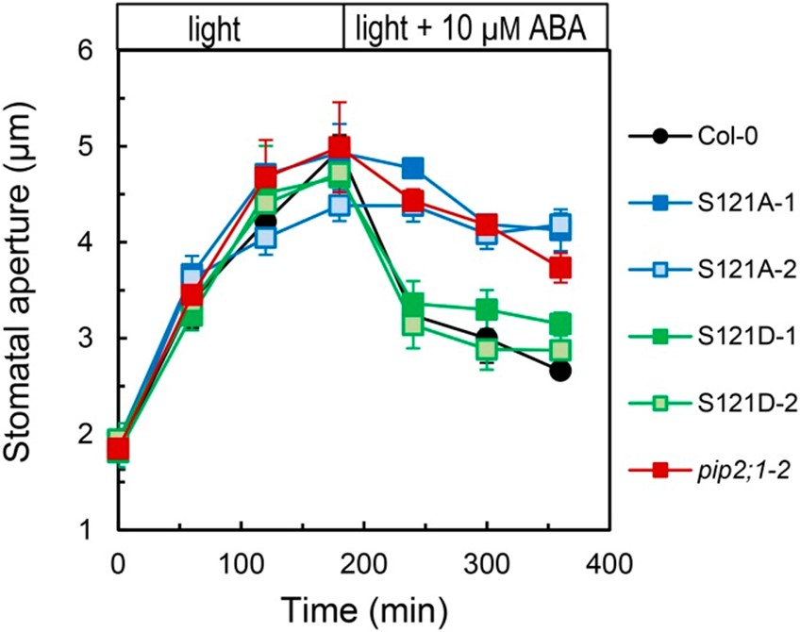
(Plant Cell 2015, Continue)
ABA
↓
Kinase
（OST1)
PIP2;1
(less active)
↓
PIP2;1
S121-Pi
(active)
↓
Water-efflux
↓
Stomatal close
Opening Inhabitation
Fig.7

Slide 21
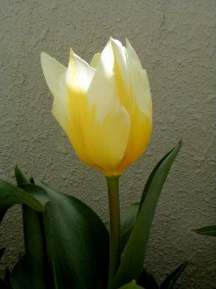
チューリップの開花
Opening tulip flower (Dr. Azad）
Plant Cell Physiology 49:1196 (2008)
低温 → 高温で開花
Low temp→high temp, then opening
花の基部の細胞が吸水
Flower cells (lower part) uptake water
PIPの発現は恒常的
PIPs express constantly
TgPIP2;2がリン酸化で高温で活性化
Phosphorylation of TgPIP2;2 (high temp); activation
低温で脱リン酸化：不活性化
Dephosphorylation of TgPIP2;2 (low temperature)

Slide 22
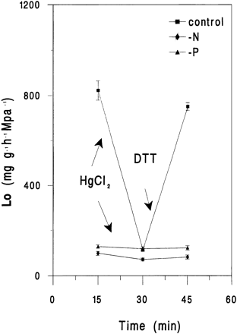
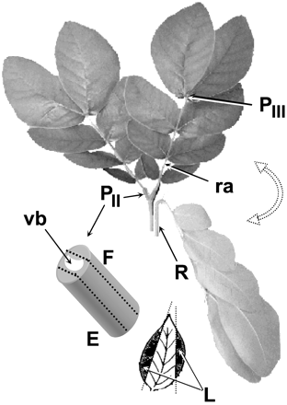
貧栄養（Low minerals）
(Dr. Carvajal）
根のアクアポリン発現量が減少
(aquaporin expression ↓)
→ 根の吸水量減少 (root water permeability↓）
→ 地上部の成長抑制 (shoot growth↓）
葉の就眠運動 （leaf movements)
(Dr. Moshelion）
朝（day）：アクアポリンの活性上昇 amount/ activity↑
→ 細胞の吸水増加(water influx) → 葉が開く
leaf open
夜(night)：アクアポリンの活性低下 amount/ activity↓
→ 細胞が脱水 (deydration) → 葉が閉じる
leaf close

Slide 23
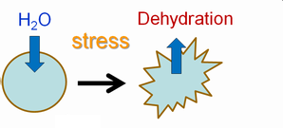
環境応答性 （Response to the environments)
塩/乾燥ストレス環境下での水輸送とPIPアクアポリン
Water transport and PIPs under Salt/drought stress
Required preventing dehydration
多様な仕組みによる柔軟かつ重要な制御
Multi-system regulation

Slide 24
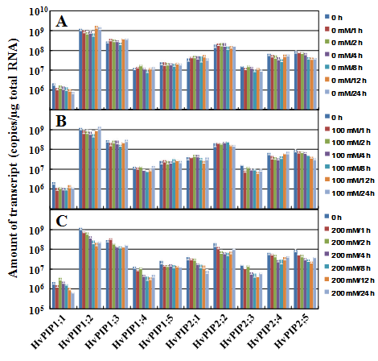
Expression regulation (suppression)
Control
100m M NaCl
(no change)
200m M NaCl
(suppression, but slow)
Horie et al. PCP 52:663 (2011)

Slide 25
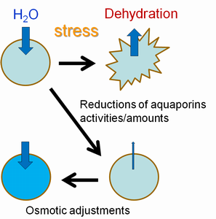
Different response of Lpr in two barley varieties showing diffent salt tolerance
(100 mM or 200 mM NaCl for 1h )
根の水透過性
耐塩性強
(salt tolerance)
耐塩性弱
(salt sensitive)
Stress
Rapid Lp_{r} doun-regulation
Prevent dehydration！
Necessary for tolerance

Slide 26
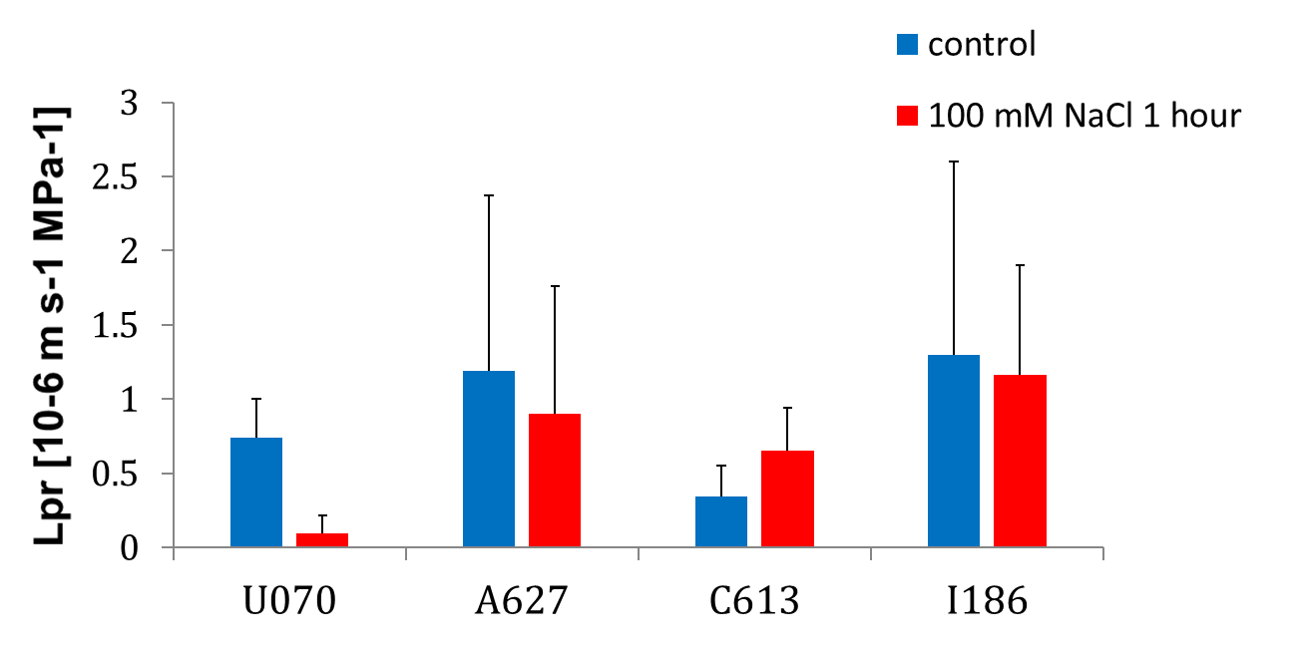
Other barley varieties
*
耐塩性強
salt tolerant
耐塩性耐弱
Salt sensitive
Kaneko et al. PCP 56:875 (2015)

Slide 27
In case of rice・・・
水稲
（耐塩性弱）
Salt sensitive
中間
middle
陸稲
（耐塩性強）
Salt tolerant

Slide 28
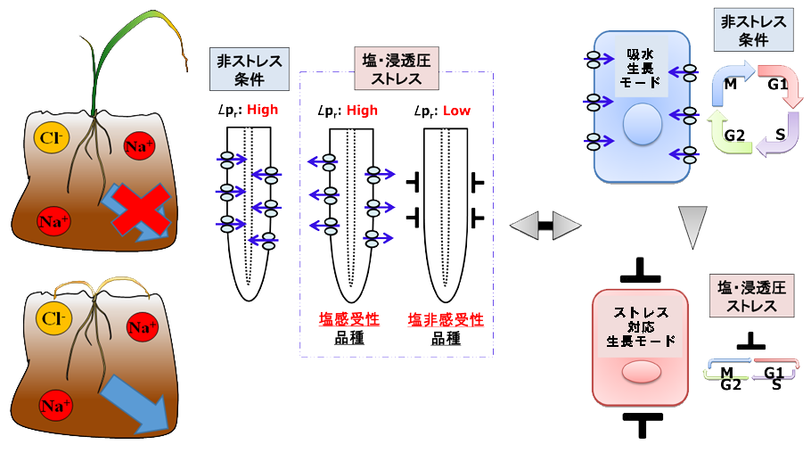
Hypothetic growth-mode change in stress tolerance
Sensitive
Normal
Salt/osmotic stress
Normal
Sensitive
Tolerance
Salt/osmotic stress
Adaptive mode
Standby mode
Tolerance

Slide 29
More details in the regulation of Lp_{r} after salt stress
オオムギBarley Lp_{r} after 100 mM NaCl (Time course)
Salt tolerance: low
Salt tolerance: middle
Salt tolerance: high
Kaneko et al. PCP 56:875 (2015)

Slide 30
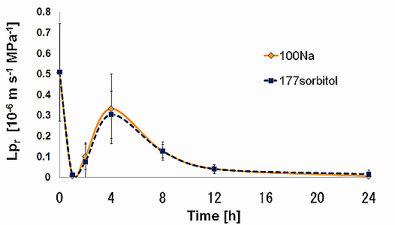
Salt/osmotic stress 1h Dephosphorylation and endocytosis
Lp_{r} of Haruna-nijo after salt
(100 mM NaCl) or osmotic
(177 mM sorbitol) stress
Osmotic aspect of salt stress
(mM)
(mM)
(μM)
(mM)
(mM)
(μM)
(μM)
Protein-dephosphorylation inhibitor (Okadaic acid; OA) and Endocytosis inhibitor (wortmannin: wm) inhibit the reduction of Lp_{r} 1 h after salt stress.

Slide 31
Dephosphorylation and internalization (cellular trafficking) function to reduce root water conductance (Lp_{r}) during the initial phase of osmotic stress
Salt/osmotic stress
Dephosphorylation
脱リン酸化
Aquaporin
Inactive
Pi
Inactive
Pi
Aquaporin
Pi
Active
Aquaporin
Endocytosis
エンドサイトーシス
Internalization
内在化
塩ストレス下での根の水透過性制御
(100 mM or 200 mM NaCl 1時間 )
Lpr reduction （透過性下方制御）
Less dehydration （脱水抑制）
Tolerance （耐性）
根の水透過性
耐塩性強
(salt tolerance)
耐塩性弱
(salt sensitive)

Slide 32
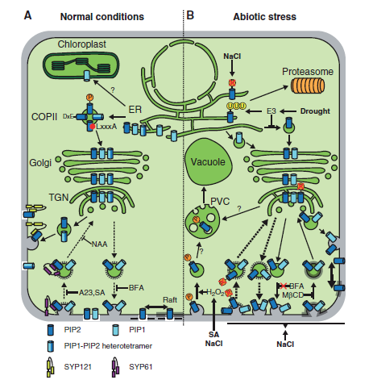
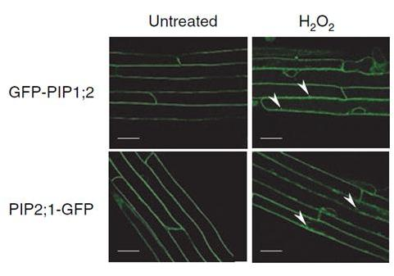
Trafficking/recycling regulation
Salt stress
↓
H₂O₂ as signal
↓
Trafficking
Internalization of fluorescence after H₂O₂ Boursiac et al. Plant J. (2008) 56, 207–218
Chevaliiner et al.
PCP 56:819 (2015)

Slide 33
Salt/osmotic stress 4h Exocytosis
Lp_{r} of Haruna-nijo after salt
(100 mM NaCl) or osmotic
(177 mM sorbitol) stress
Pi
aquaporin
Pi
aquaporin
Exocytosis
エキソサイトーシス
Exocytosis inhibitor (brefeldin A : BFA ) inhibit transient recovery of Lp_{r} 4h after salt stress.

Slide 34
Salt/osmotic stress >4h Protein degradation
Lp_{r} of Haruna-nijo after salt
(100 mM NaCl) or osmotic
(177 mM sorbitol) stress
Proteasome inhibitor (MG132 ) inhibits reduction of Lp_{r} after stress > 4 h

Slide 35
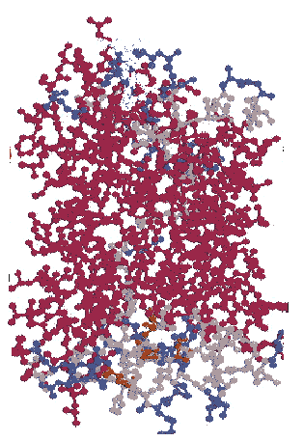
Salinity (Osmotic) stress
Non-stress
Osmotic stress
signal
H₂O
PIP aquaporin
WM
OA
P
（<4h）
Severe stress
BFA
P
Transient
Pool
（>200 mM NaCl）
Mild stress
Activate
（>4h）
MG132
mRNA & Protein degradation
Protein degradation
Proteasome（プロテアソーム）

Slide 36
通常 (normal)
リン酸化・・・活性↑ （水吸収）
Phosphorylation: water transport activity ↑
塩/乾燥ストレス 脱水抑制が必要
Salt/drought stress Required preventing dehydration
早い反応（分単位） ➡ 脱リン酸化
Quick response (minutes): Dephosphorylation
やや早い反応（時間単位） ➡ 細胞内輸送制御
Mid-speed response ( a few hours): Internalization
ゆっくりした反応（数時間～日） ➡ タンパク分解、発現抑制
Late response (hours to days): Protein degradation
Expression repression
多様な仕組みによる柔軟かつ重要な制御
Multi-system regulation

Slide 37
光環境とイネ根のPIPアクアポリン
Light and Rice PIPs in roots
Light
Stomatal opening
Transpiration ↑
Need much water-uptake
PIP expression in roots ↑
(hormonal regulation ?)
Dry (RH=40～50%)
Humid (RH=90%)
12
OsPIP2;1
10
OsPIP2;5
8
mRNA amounts
(x 10⁶ copies / 1μg total RNA)
mRNA amounts
(x 10⁶ copies / 1μg total RNA)
6
4
2
0
-11 0 2 4 6 8
-11 0 2 4 6 8
light
, but evaporation-dependence
実は蒸散要求（湿度）に応答
(Dr. Murai)

Slide 38
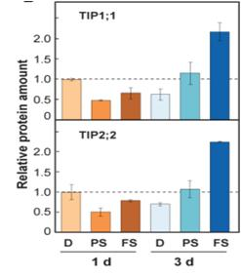
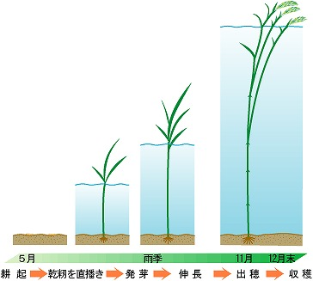
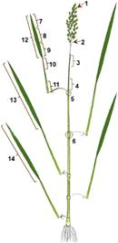
冠水適応に関与する浮イネのOsTIPs
（OsTIPs in Deepwater rice)
2.0
1.5
1.0
0.5
0
OsTIP1:1
(Dr. Maeshima)
Relative protein amount
2.0
1.5
1.0
0.5
0
2.0
1.5
1.0
0.5
0
OsTIP2;2
Water
celle
A
H
N
A
H
N
vacuole
1 day 3 days
Submergence
N:non 無冠水
H:Half 半冠水
A：all 全冠水
node
Submergence （冠水）
TIP expression ↑
Vacuolar elongation
Cell elongation
Internode elongation
（節間伸長）
internode
node

Slide 39
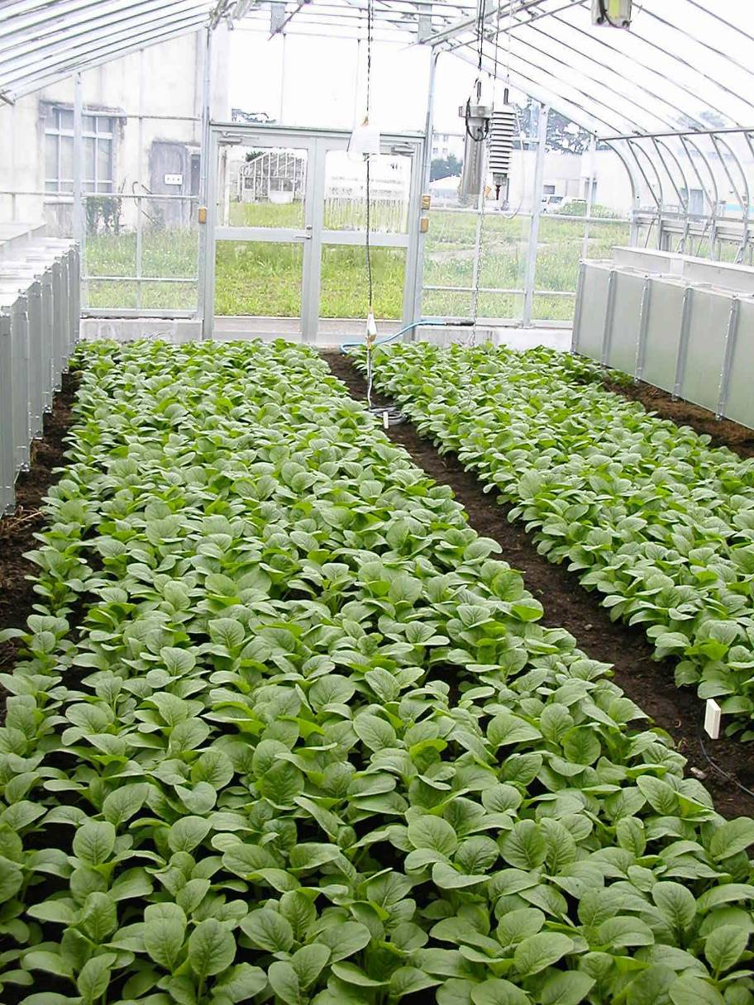
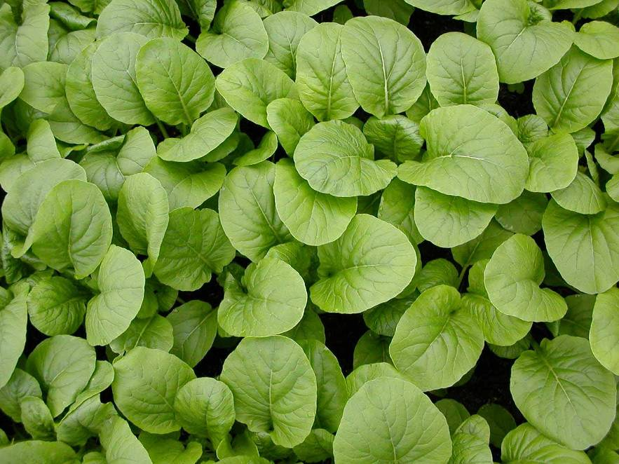
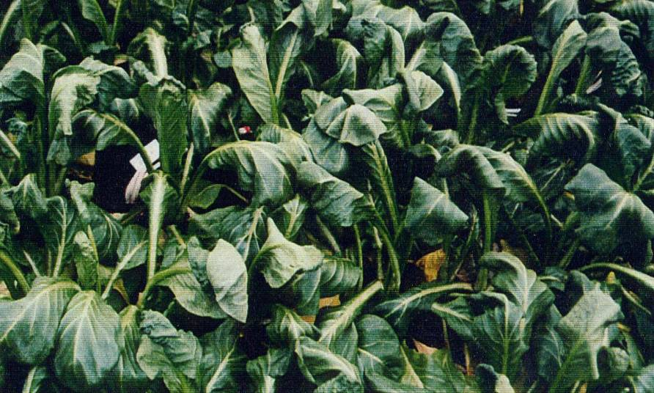
低温と水透過性
Low temperature and water permeability
(Dr. Murai)
正常な葉 (normal)
低温による葉のしおれ
（chilling damage)

Slide 40
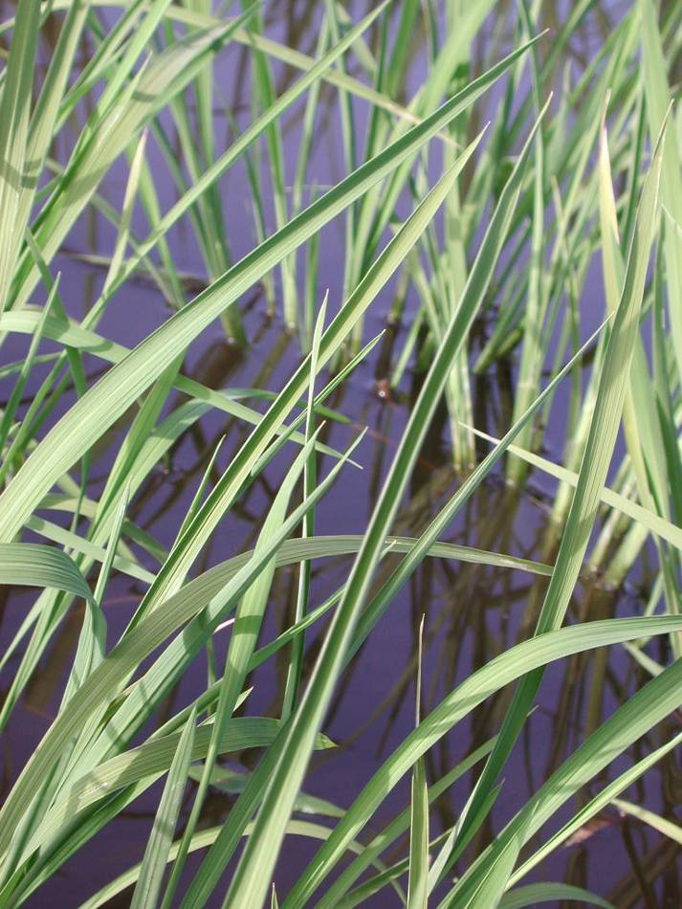
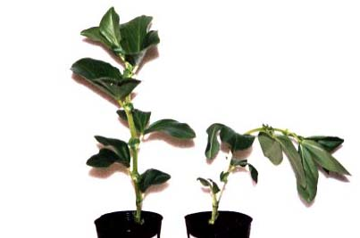
Rice
Fava bean
Upper 5ºC 5ºC
Under 25ºC 5ºC
Cold water
Chilling in roots → Root PIP activity↓ → Water absorption↓

Slide 41

Low temperature
Other example
キュウリ
Cucumber
低温感受性
Chilling sensitive
Lost in turgor
クロダネカボチャ
Figleaf Gourd
低温耐性強
Chilling tolerant
(Dr. Chung)

Slide 42

セルプレッシャープローブ
（Cell presser probe）

Slide 43
Cucumber (sensitive)
Figleaf gourd (tolerant)
Less aquaporin activity
Chilling in roots →
(sensitive) Root PIP activity↓ → Water absorption↓
(tolerant) Root PIP activity, Water absorption (no change)

Slide 44
Substrates （輸送基質）:
Glycerol
water
B(OH)₃
Si(OH)₄
NH₃
As(OH)₃
Lactate
H₂O₂
CO₂
Low molecular weight, most neutral

Slide 45



ケイ素 Si
Oocyte実験系
Si analog
⁶⁸Ge (RI) was used for uptake experiments
● Lsi1(=OsNIP2;1)-injected
○ water-injected
Ma et al. (2006)

Slide 46
過酸化水素 H₂O₂
ROS（exclude)
Signaling（required）
H₂O₂
Toxic Assay
Aquaporins transporting H₂O₂
H₂O₂
Lethal (dead)
In the presence of external H₂O₂
Certain Aquaporins transporting H₂O₂
ROS removal system
_{Lethal}
Skn７
ΔSkn7 yeast

Slide 47




0 mM H₂O₂
0.25 mM H₂O₂
HvPIP2;4
HvPIP2;3
HvPIP2;5
HvPIP2;2
HvTIP2;2
HvPIP2;1
pYES2
(Vector)
0.5 mM H₂O₂
0.75 mM H₂O₂
HvPIP2;5 and HvTIP2;2 are H₂O₂-transporting Aquaporins

Slide 48


As(OH)₃
Toxic, chemical homology to silicic acid
No As
5μM-As
pYES2
HvNIP1;1
HvNIP1;2
HvNIP2;1
HvNIP2;2
AtNIP1;1
AtNIP5;1
OsNIP1;1
OsNIP2;1
OsNIP2;2
OsNIP3;1
OsNIP3;2
OsNIP3;3
OsNIP4;1
intermediate
intermediate
Notes:
SC-Ura(+Gal)寒天培地は任意のAs, B濃度で作成した後約1週間4℃下で保存・浸透させておいた。
Replica colonyをSC-Ura(+Gal)液体培地に懸濁し、O.D.₆₀₀=0.01に合わせ希釈したものを×1とし、順次×10, ×100希釈したものを3μLスポットした。
30℃・4days培養を行った。 Acr-3株 （2013年4月22日実験）

Slide 49
As(OH)₃ permeable rice and barley aquaporins
3 aquaporins in rice
3 aquaporins in barely
11 PIPs
7 TIPs
7 NIPs
10 PIPs
8 TIPs
4 NIPs
OsPIP1;1
OsPIP1;2
OsPIP1;3
OsPIP2;1
OsPIP2;2
OsPIP2;3
OsPIP2;4
OsPIP2;5
OsPIP2;6
OsPIP2;7
OsPIP2;8
OsTIP1;1
OsTIP1;2
OsTIP2;1
OsTIP2;2
OsTIP3;1
OsTIP4;2
OsTIP5;1
OsNIP1;1
OsNIP2;1
OsNIP2;2
OsNIP3;1
OsNIP3;2
OsNIP3;3
OsNIP4;1
HvPIP1;1
HvPIP1;2
HvPIP1;3
HvPIP1;4
HvPIP1;5
HvPIP2;1
HvPIP2;2
HvPIP2;3
HvPIP2;4
HvPIP2;5
HvTIP1;1
HvTIP1;2
HvTIP2;1
HvTIP2;2
HvTIP2;3
HvTIP3;1
HvTIP4;1
HvTIP5;1
HvNIP1;1
HvNIP1;2
HvNIP2;1
HvNIP2;2
(intermediate)
Plant Biotechnology 31:213 (2014)
Physiologia Plantarum 159:120 (2017)

Slide 50
光合成の3つの律速段階とCO₂透過性アクアポリンの関係
(photosynthesis and CO₂-permeablr aquaporins)
CO₂
3 limiting steps
Stomatal conductance
気孔
Stomata
Intercellular space
Mesophyll conductance:
CO₂ permeability via AQP
RubisCO
RubisCO activity
葉緑体
Chloroplast
Some aquaporins
葉肉細胞
Mesophyll cell
Notes:
分子基盤としてのアクアポリン

Slide 51


CO₂ transport activity using oocyte
External CO₂/H₂CO₃濃度
PIP cRNA
Oocyte(卵母細胞)
CA
Micropipette
Carbonic-anhydrase (CA)
Micro pH electrode
（pH電極）
CA
Aquaporin
Voltage
electrode
CO₂
CA
(PCP 55: 251, 2014)
CO₂ → HCO₃⁻ + H⁺ (pH変化検出)

Slide 52


透過CO₂性PIPを過剰発現させたら光合成能が向上するか？
Does over-expression of CO₂-permqable PIP increase photosynthetic activity?
HvPIP2;1を過剰発現させたイネ
HvPIP2;1
タンパク量
PCP, 45:525 (2004)
葉内部の
CO₂ 透過性
光合成

Slide 53
Aquaporins in Chloroplast envelope and/or thylakoid membrane
In rice, OsTIP2;2 is tentatively detected as a CO₂ transporter
(Katsuhara lab).
Fig.1 Water transport across chloroplast membranes and its use during photosynthetic reactions.
“Assessment of the requirement for aquaporins in the thylakoid membrane of plant chloroplasts to sustain photosynthetic water oxidation. “ Beebo FEBS Letters (2013)

Slide 54




sfGFP-OsTIP2;2 transgenic rice（Ox)
＜RubAc-promoter＞
（Nakahara, Katsuhara Unpublished)
（Plant leaf section)
Chlorophyll
Chl+GFP
Chl+GFP+Bright filed (明視野)
（Protoplast)
Chlorophyll
GFP
Chl+GFP
Chl+GFP+Bright filed
Bright field
（明視野）

Slide 55
Some summary of aquaporins
Water ・・・・ multi-regulation system via aquporins
application： Enhancement of water-related stresses
CO₂ ・・・・ Plasmamembrane+Choloroplast？
application： Increase photosynthetic activity
H₂O₂・・・・ Some PIPs have specific activity
application： ROS removal
Enhancement of signal transduction

Slide 56
塩ストレス環境とイオン輸送系
(理論的側面と分子機構）
Salt stress and ion transport (theory and molecular aspect)

Slide 57
細胞の構造と無機イオン輸送の関係
(Inorganic) Ion transport and cell structure
Nuc
Vacuole
Exclude
Ion
Isolation
Accumulation
Selection
ATP
Ion（low concentration）

Slide 58
Tolerant/sensitive determinants and transport system
Cell/Individuals
Tolerant？Sensitive？
Tolerant mechanisms: compartmentation, no absorption, exclusion, changeing target(s) to be insensitive
Target
Tarｇet
Elements
（toxic materials）
Detoxification
Compartmentation
Sensitive（感受性）： Originally no tolerant mechanism
Inactivation of tolerant mechanism
→ Disturbance in metabolism and others
(Injory mechanism)

Slide 59
輸送の基本 ・・・ 濃度勾配（濃度差）
Movement ・・・ Gradient (Concentration)
「電気化学ポテンシャル」(electrochemical potential)とは
「濃度差と電位差の両方を考慮したもの」
(including both gradient of concentration and electric field)
+
+
+
+
+
+
- -(minus charge)
- -
+
+
+
+
+
+
+
+
+
10倍の濃度差と、59mVの電位差がつりあう
Balance between 10-hold concentration gradient and 59 mV

Slide 60

電気化学ポテンシャル（の正式）
Electrochemical potential (formula)
標準状態の化学ポテンシャル (standard chemical potential) μ*
気体定数 (Gas Constant) R 絶対温度 (Abs. Temp.) T 活量 (activity) a
粒子のイオン価 (charge No.) z ファラデー定数 (Faraday Const.) F
電位 (electric potential) φ
平衡電位 (Reversal (Equivalent) potential) E_{m} or E_{rev}
ネルンストの式: Nernst equation
膜内外で一価（下図の場合K⁺）が平衡しているときは・・・
外側基準
(outer is zero standard)
K⁺
K⁺ K⁺ K⁺ K⁺ K⁺
K⁺ K⁺ K⁺ K⁺ K⁺
(In case of K⁺)

Slide 61
ポンプ (Pump)
エネルギーを直接使って、電気化学ポテンシャル勾配に逆らって、物質を輸送する
(Against electrochemical gradient, using energy)
H⁺
H⁺
H⁺
H⁺
H⁺
Example: H⁺ -ATPase
輸送速度は毎秒１０^{２}個
(10² molecules per sec)
ATP
ADP + Pi
H⁺

Slide 62
トランスポーター (Transporter)
ある物質X（たいていH＋）の電気化学ポテンシャル勾配を利用して、目的の物質Yを濃度勾配に逆らって輸送する (Using electrochemical gradient of X (H＋in most case), transporting Y against Y’s electrochemical gradient)
Na⁺
Na⁺
H⁺
H⁺
H⁺
H⁺
H⁺
Na⁺
Na⁺
Example: Na⁺-H⁺ -antiporter
Na⁺
Na⁺
H⁺
Na⁺
H⁺
輸送速度は毎秒１０³個
(10³ molecules per sec)

Slide 63
チャネル (channel)
一部のトランスポーター （Some Transporter）
目的の物質を、電気化学ポテンシャル勾配濃度勾配にしたがって（促進的に）輸送する
(Transport X according to its electrochemical gradient)
K⁺
K⁺
glucose
K⁺
glucose
K⁺
K⁺
- - -
- - -
K⁺
glucose
Example: K⁺ -channel
Example: Glucose transporter
輸送速度は毎秒１０⁸個以上
(10⁸ molecules per sec)
輸送速度は毎秒１０³個
(10³ molecules per sec)

Slide 64
細胞膜電位 （静止電位）
Membrane potential (Resting potential)
⋍ K⁺の平衡電位 E_{m} of K⁺
（動物も植物も）
細胞膜電位 ＝ 非起電性成分
Membrane potential non-electrogenic ones
（細胞内の非移動性負電荷） intracellular immobile negative charges
＋
起電性成分（起電性ポンプ）
electrogenic ones (electrogenic pump)
動物と植物はここが違う！
Plant unique

Slide 65
Resting potential of living cells
Animal cells Plant cells
Na⁺-K⁺-ATPase （electrogenic pumps） H⁺-ATPase
-70 ～ -90 mV -100 ～ -200 mV

Slide 66
Exclusion of Na⁺(How to low [Na⁺]_{cyt})
Animal
High[Na⁺]_{out}が基本
Na⁺-K⁺-ATPase
Plant
[Na⁺]_{out} -freeが基本
No Na⁺-K⁺-ATPase except sea algae
（海産藻類は例外）
For exclusion of [Na+]_{cyt} ・・・ Na⁺/H⁺ antiporter

Slide 67
Basic difference of secondary transport system between animal and plant.
Animal
Using Na⁺ gradient
Plant
Using H⁺ gradient
symport
antiport
(co-trasnport)
（例外的に）植物細胞にも存在
Some specially in plant cells

Slide 68



Ion channel study using the electrophysiology
Cell recording （Twin Electrode Voltage Clamp)
Ion flux was detected as electric current
Electric current is sum of single-channel currents
従来の電気生理
（classical electrophysiology）
I-V relationship (plot)
Positive current = positive charge efflux
(or negative influx)
With channel
10-hold concentration
difference
Reversal potential
59 mv difference
(monovalent)
No channel
Negative current = positive charge influx
(or negative efflux)

Slide 69


Ion channel study using the electrophysiology
Cell recording （Twin Electrode Voltage Clamp)
Ion flux was detected as electric current
Electric current is sum of single-channel currents
従来の電気生理
（classical electrophysiology）
パッチクランプ (Patch Clamp) single channel recording
１９９１年 ノーベル賞
Nobel prize 1991
https://www.leica-microsystems.com/science-lab/the-patch-clamp-technique/
https://en.wikipedia.org/wiki/Patch_clamp

Slide 70

Various mode of patch-clamping
http://www.bem.fi/book/04/04.htm

Slide 71


Example of cell-attached patch (ATP-dependent cation channel)
open
ion⁺
close
E_{rev}
（逆転電位）
Reversal potential
↑外向き電流
outward current
ion⁺
Outward current ・・・
＋ ion efflux （外向きの流れ）
または
－ ion influx（内向きの流れ）
↓内向き電流
inward current

Slide 72
E_{rev} tells flux ions and selectivility
（１）イオンMの平衡電位（Nernstの式）と、MがK⁺の場合
（２）３つの主要イオンで電位が決まる場合のGoldmanの式
（３）Cl－の透過性が低い場合、Na＋とK＋の選択性αが求められる
If Cl⁻ permeabiliy (P_{Cl}) is low, selectivity between Na＋ and K＋ is calculated.

Slide 73
P_{Na}/P_{K} （α）= 0.28
（Fresh water Chara cells）
E_{rev}
（逆転電位）
Na⁺can be transported via K⁺channel.
Plasma membrane
原形質膜
K⁺
out in
[K⁺]_{in} = 100, [K⁺]_{out} = 0.1,
[Na⁺]_{in} = 0, [Na⁺]_{out} = 100
(cyt side is “in”）
Na⁺
Salt tolerant （brackish） characeae species has very low α (α ≒０), that is, Na⁺can not enter into cells via K⁺channel. 汽水性（耐塩性）種ではNaは通らない

Slide 74

カリウムチャネルの分子構造
Molecular structure of K channel
放線菌のKcsAチャネル
Actinomycetes Kcs
（現代科学２００４年１月号より）
By Mackinonn
２００３年ノーベル賞
Nobel Prize 2003

Slide 75


カリウム輸送系とナトリウムの吸収
Potassium transporter and sodium uptake
Multi-system: Physiology and transporters
オオムギ切断根のカリウム吸収速度と培地カリウム濃度の関係
複数の輸送体の寄与を示唆 Epstain, Nature 212:1324 (1966)
植物（シロイヌイナズナ）のカリウム輸送系遺伝子
塩ストレスでは・・・
Under salt stress・・・
Na⁺
代謝と膜電位の攪乱
Na⁺↑
K⁺
K⁺↓
Disturbance of membrane potential and metabolism

Slide 76

K⁺
out in
Na⁺
Na-K co-transporter Arabidopsis HKT
（Science 270:1660, 1995）
Na/K 共輸送
symport
「植物の膜輸送システム」
（秀潤社）より

Slide 77
別のNa輸送システム（ＳＯＳ系）Salt stress sensitivity test／bending assay
Sensitive
Mutant
(SOS mutant)
by Dr. Zhu
inversion
wild type
5-day-old plant without salt stress
salt stress for several days

Slide 78
SOS1-mutant
K⁺
SOS3
SOS2
Na⁺
Na⁺
Na⁺
X
H⁺
NHE
KAT
AKT
HKT
・・・
SOS1
(Na/H antiporter)
SOS2: CIPK24
SOS3: CBL4
5th
class

Slide 79


Localization and function of AtHKT and SOS1
ＡｔＨＫＴ１とＳＯＳ１の植物体内での生理的役割
SOS1:
Na-H antiporter
AtHKT1 : Na-transporter (no K-transport activity)
(Note: Some HKTs are Na/K transporters)

Slide 80

High sodium (Na) ; Salt stress
K-deficiency and moderate Na;
Substitution
Beneficial
代替（有益）
Rice (Koshihikari)
○ | イネ rice オオムギ barley ワタ cotton キャベツ cabbage ホウレンソウ spinach ビート beat ・・・
× | トウモロコシ maize アブラナ Brasicca ダイズ Soybean
（「植物栄養学」第２版）
Molecular mechanism for Na uptake in rice: One of OsHKT?

Slide 81




イネHKT
OsHKT2;1 expression under K-deficiency → candidate?
(EMBO J 26:3003, 2007)
(Plant Physiology 152:341, 2010)
OsHKT2;1 : Na-transport
(not K-dependent)
OsHKT2;2：
K-dependent Na-transport
and
Na-dependent K-transport
（タバコ培養細胞に発現させて測定 in Nicotine cell）
NOTE: Difference between rice and Arabidopsis HKTsシロイヌナズナHKTはイネと違う

Slide 82


Schematic summaries of Na⁺ influx pathways into saline roots (in case of rice)
Primary protective mechanisms mediated by Na⁺ transporters on important biological membranes
Rice5：11 (2012))
Apoplastic bypath flow
注意：植物種によって、イオン選択性は異なる
NOTE: Difference among plat species

Slide 83
Paper reading in the next class (May 29)
次回課題論文
Sodium-driven potassium uptake by the plant potassium transporter HKT1 and mutations conferring salt tolerance.
F Rubio, W Gassman, J I Schroeder
Science, 270:1660-1663 (1995)
Students will be asked to explain figures, in addition to small test.
小テストのほか、各自、論文の図の説明もできるように理解してくること．

